Slide 1
SRO TRANSFORMATION ARCHITECTURE
Land Tax — Value Stream Map
Replication Pack for Copilot
This pack contains: Visual screenshots of all UI states · Full specification document · Raw data (JSON) · Complete HTML source
01 Screenshots
10 UI states across all interactions
02 Spec Doc
Architecture, CSS tokens, data model, interactions
03 Data (JSON)
Complete DATA array — all 49 L3 capabilities
04 HTML Source
Complete self-contained HTML file

Slide 2
01
Navigation & Default State
How the component appears on load and how stage selection works.

Slide 3
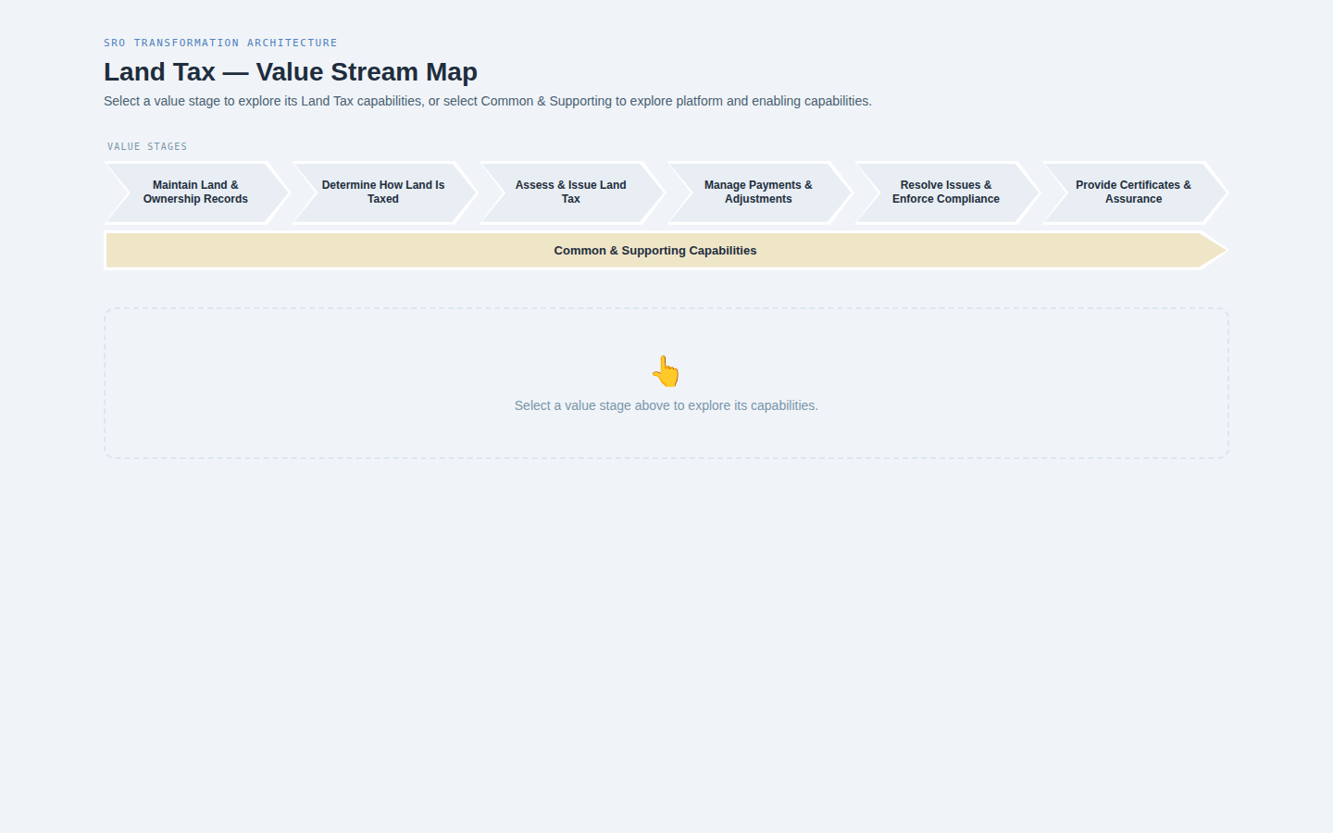
01 — Default State (on load)
No stage selected
📌 Six chevrons + Common & Supporting bar. Empty state with prompt. No panel visible.

Slide 4
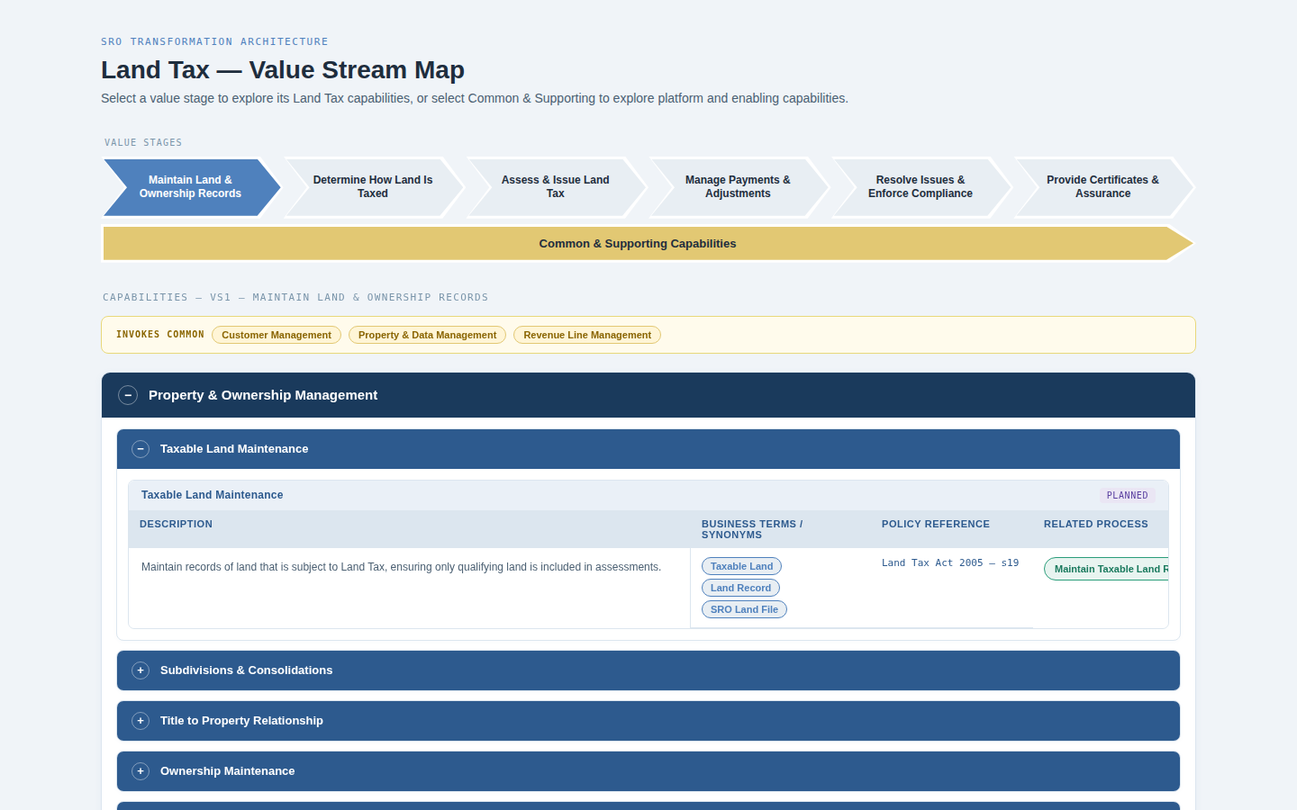
02 — VS1 Selected
Maintain Land & Ownership Records
📌 First chevron highlighted blue. Invokes Common bar appears. L1 block auto-opens with first L2 expanded.

Slide 5
02
Value Stage Panels
Each of the six value stages showing their Land Tax L3 capabilities.

Slide 6
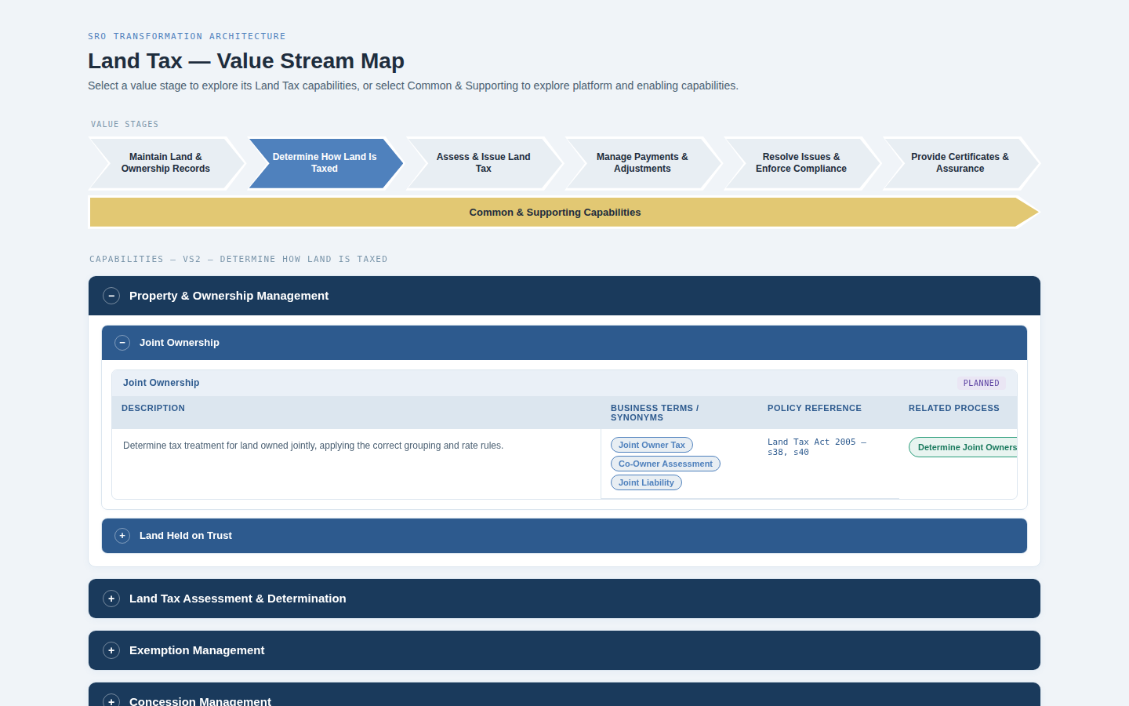
03 — VS2 Selected
Determine How Land Is Taxed
📌 12 L3 capabilities. No Invokes Common bar — all capabilities are Land Tax specific.

Slide 7
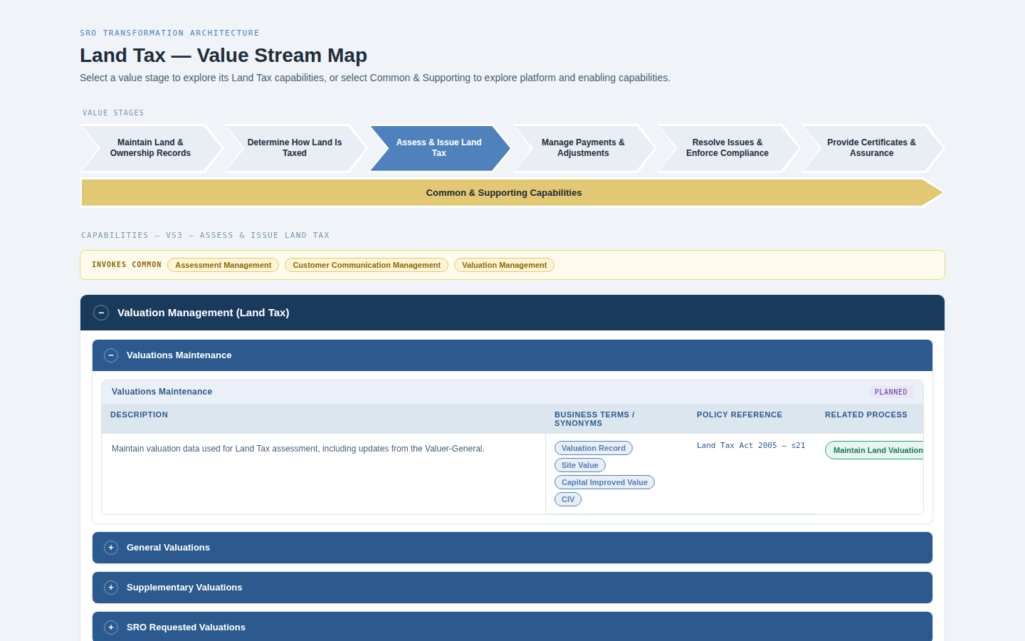
04 — VS3 Selected
Assess & Issue Land Tax
📌 13 L3 capabilities. Invokes Assessment Management, Customer Communication Management, Valuation Management.

Slide 8
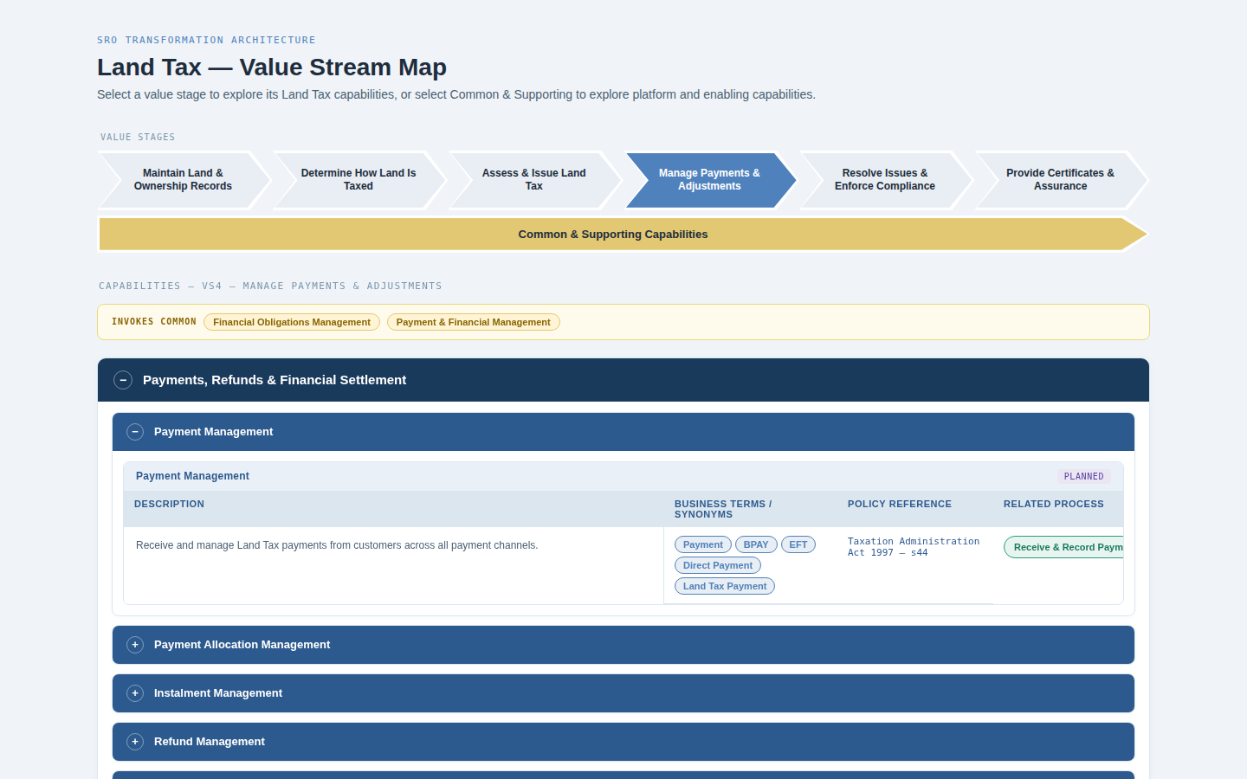
05 — VS4 Selected
Manage Payments & Adjustments
📌 6 L3 capabilities. Invokes Financial Obligations Management and Payment & Financial Management.

Slide 9
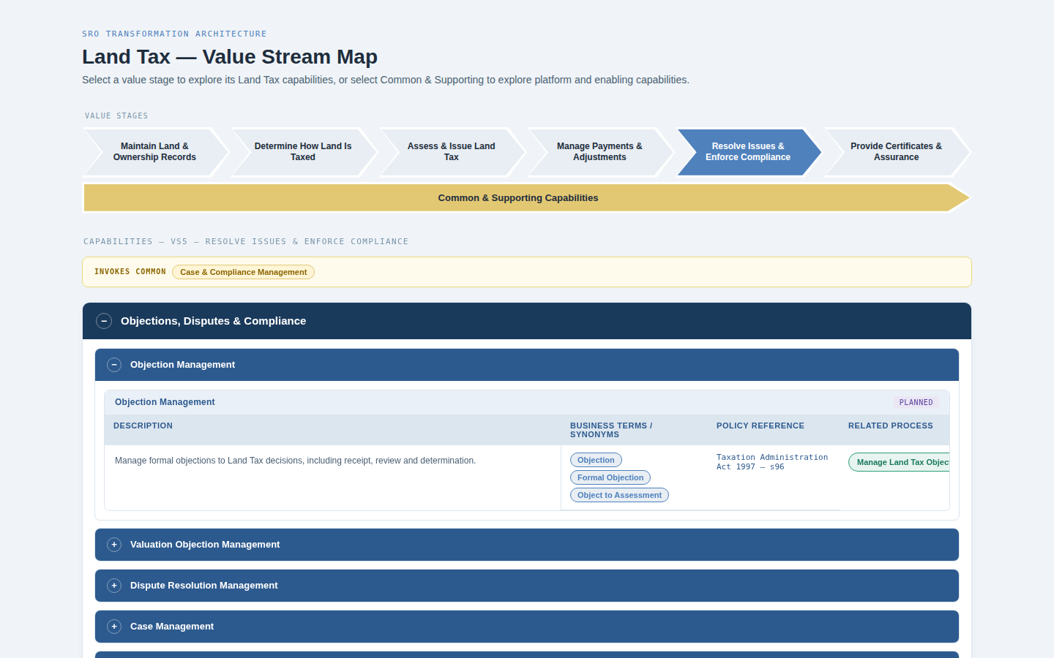
06 — VS5 Selected
Resolve Issues & Enforce Compliance
📌 9 L3 capabilities. Invokes Case & Compliance Management.

Slide 10
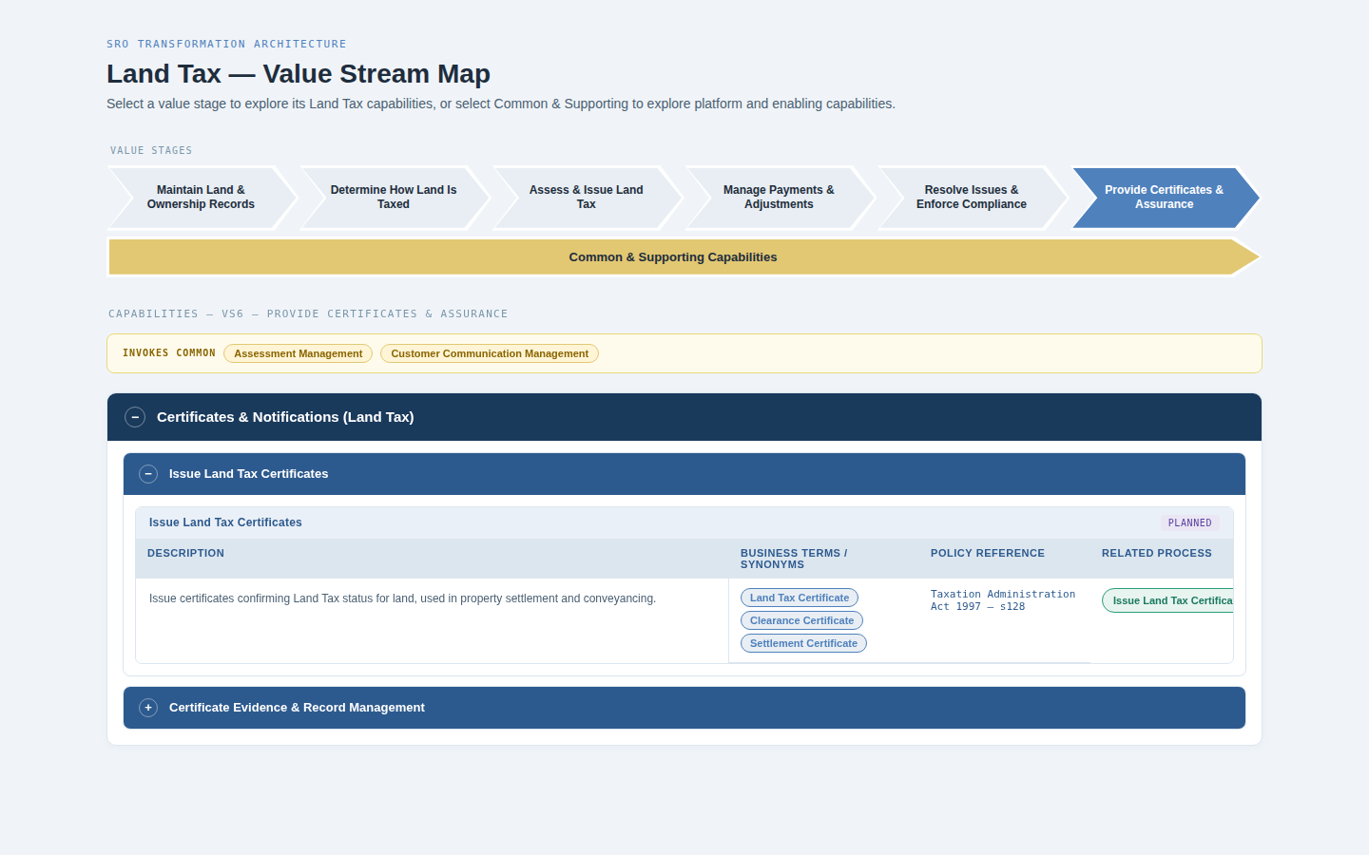
07 — VS6 Selected
Provide Certificates & Assurance
📌 2 L3 capabilities. Invokes Assessment Management and Customer Communication Management.

Slide 11
03
L2 Expand / Collapse Interaction
L2 blocks are collapsed by default (except the first which auto-opens). Click header to toggle.

Slide 12
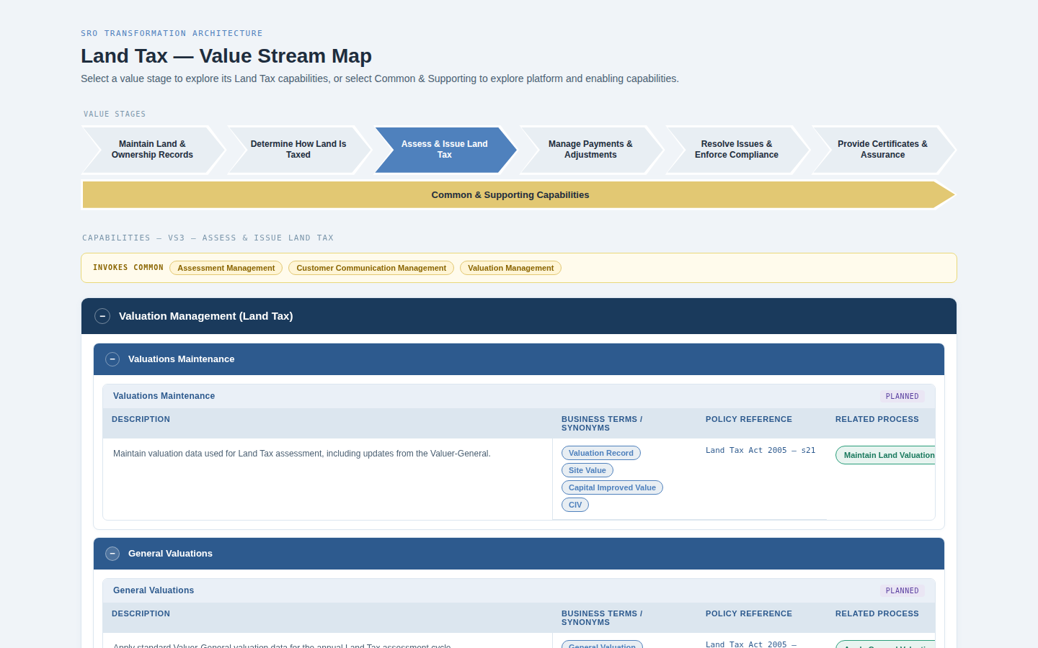
08 — Multiple L2s Expanded
VS3 with second L2 also open
📌 Each L2 header click toggles open/close. + becomes − when open. L3 grid shows Description, Synonyms, Policy, Related Process.

Slide 13
04
Common & Supporting Capabilities Panel
Selecting the amber bar reveals platform capabilities and Support & Govern.

Slide 14
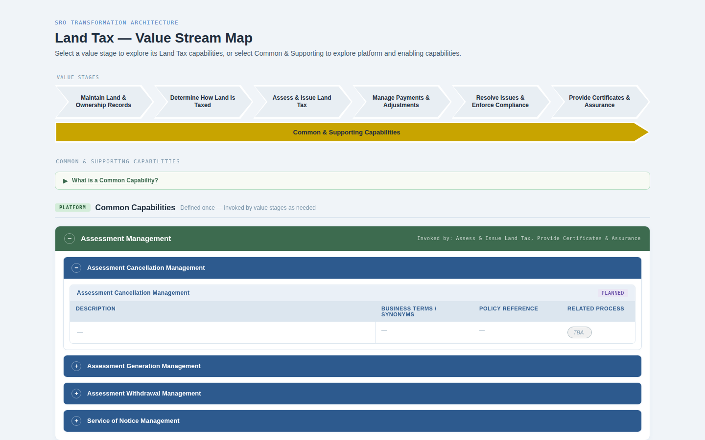
09 — Common & Supporting (collapsed)
Definition block closed
📌 Section dividers separate Platform Common Capabilities (green headers) from Support & Govern (purple headers). Definition link at top.

Slide 15
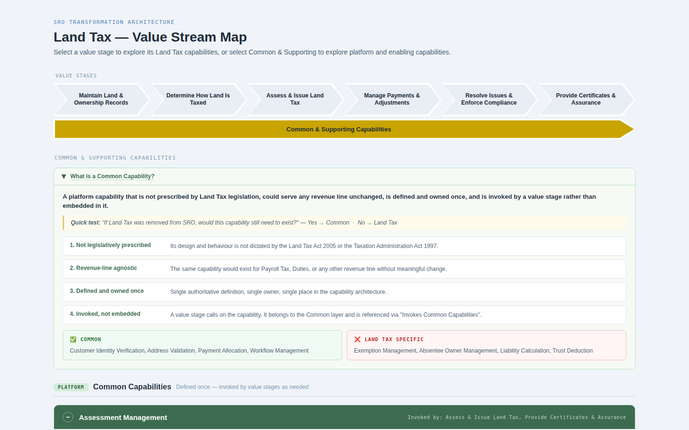
10 — Common & Supporting (definition expanded)
Definition block open
📌 Expandable definition block shows brief definition, quick test, four criteria, and examples. Arrow rotates on open.

Slide 16
05
Maturity Badges & Process CTAs
Every L3 shows a right-justified maturity badge in its name bar and a Related Process CTA pill.

Slide 17
11 — L3 Detail View
Name bar + grid columns
📌 Maturity badge (purple=Planned) right-justified in L3 name bar. Process CTA pill (green, →) in Related Process column. TBA = muted grey, non-clickable.

Slide 18
Reproduction Rules
Output
Single self-contained .html file — no external CSS or JS files
Fonts
Inter (400/500/600/700) + Roboto Mono (400/500) from Google Fonts
Framework
Vanilla JS only — no React, Vue, Angular or any framework
Data source
DATA array only — 6 stages, 49 L3 capabilities with process names
Chevron geometry
CSS clip-path polygon — left notch 26px, right point 26px, white 3px border
Interaction
selectStage(i) — deselects all, selects clicked, highlights Common bar
Auto-open
First L1 and first L2 open automatically on stage selection
Maturity badge
Right-justified in l3-name-bar flex row — 5 colours, JetBrains Mono 10px
Process CTA
Green pill with → arrow, href='#' — muted grey italic when TBA
Common panel
selectCommon() — toggles is-selected on common bar, deselects stage chevrons

